Slide 1


XRP Cryptocurrency Return Prediction
Course Code:BCSE498J
Guide Name:
Ramanathan.L
Team Members:
Namineni Sai Loukya – 21BCE2127
Ravi Pranavi – 21BCB0112

Slide 2

Outlines/Content
1
Introduction
Literature Review
Problem Formulation
Relevance to SDGs
Proposed System/Architecture/Design
Analytical and Theoretical Description
Hardware/Software Tools and Design Parameters
Workflow Model
Design and Implementation
Results Analysis
Conclusion
Contribution of Team Members
Impact on Society and Environment
Outcome (Publication/Patent/Conference/Book Chapter)
References

Slide 3

2
INTRODUCTION
XRP is a cryptocurrency and the primary token in the XRP ledger which is an open source. Several investors in the advancing stock market consider cryptocurrency purchases as investments that are highly profitable. However, accurately predicting stock prices is challenging due to the complexity and dynamic nature of financial markets.
This study explores the predictive modelling of XRP returns by leveraging machine learning-based frameworks. The dataset undergoes preprocessing, including handling missing values, feature engineering, and data scaling to ensure robust model performance. Multiple regression models like XGBoost, Linear Regression, Random Forest, and Support Vector Regression are trained and evaluated for their performance.
This research points out XGBoost and Random Forest as the top performing models since they are scalable and capable of learning the non-linear relationships. Features importance analysis and comparative evaluation support effective decision making in cryptocurrency trading strategies. This study provides a valuable tool to analyze the trends in the volatile cryptocurrency market and predict the return prices by leveraging advanced machine learning techniques.

Slide 4
3
LITERATURE SURVEY
Title | Author(s) | Year | Objective
Predicting Bitcoin Returns Using High-Dimensional Technical Indicators | Jing-Zhi Huang, William Huang, Jun Ni | 2019 | Investigates whether Bitcoin returns are predictable using a large set of Bitcoin price-based technical indicators and constructs a classification tree-based model for return prediction.
Deep Learning for Bitcoin Price Direction Prediction: Models and Trading Strategies Empirically Compared | Oluwadamilare Omole, David Enke | 2024 | Applies deep learning models to predict Bitcoin price direction and assess the profitability of trading strategies. Compares CNN–LSTM, LSTNet, TCN, and ARIMA models using on-chain data and feature-selection techniques.
Bitcoin Return Prediction based on OLS, Random Forest, LightGBM, and LSTM | Gaohao Zhu | 2023 | It compares their accuracy in forecasting Bitcoin returns to provide insights for investors and validate machine learning applications in cryptocurrency prediction.
XRP Price Prediction Using Advanced Deep Learning Models | Alpesh Ranjan, Varad Nilakhe, Ved Bhatkar, Bhushan Iinje | 2023 | The research focuses on analyzing historical price data and implementing feature selection techniques to improve prediction accuracy. The model is designed to help traders make informed investment decisions and automate XRP trading strategies.
Forecasting Returns Volatility of Cryptocurrency by Applying Various Deep Learning Algorithms | Farman Ullah Khan, Faridoon Khan, Parvez Ahmed Shaikh | 2023 | Includes Neural Network Autoregressive (NNETAR), Cubic Smoothing Spline (CSS), and Group Method of Data Handling Neural Network (GMDH-NN) and evaluates their predictive accuracy across Bitcoin, Ethereum, XRP, and Tether, comparing their forecasting performance.

Slide 5
4
LITERATURE SURVEY
Title | Author(s) | Year | Objective
Cryptocurrency Price Forecasting Using XGBoost Regressor and Technical Indicators | Abdelatif Hafid, Maad Ebrahim, Ali Alfatemi, Mohamed Rahouti, Diogo Oliveira | 2024 | It integrates technical indicators like EMA, MACD, and RSI with historical market data, aiming to improve prediction accuracy and assist traders in navigating cryptocurrency market volatility.
Bitcoin Price Prediction using Recurrent Neural Networks and Long Short-Term Memory | Pradeep Sudhakaran, Vaibhav Sharma, Shreyanshi Khandelwa | 2024 | Utilizes data from the Kraken exchange, incorporating factors like transaction volume, hash rate, and Google search trends. The aim is to improve prediction accuracy and provide insights for investors navigating Bitcoin’s volatility.
Deep Learning Algorithm to Predict Cryptocurrency Fluctuation Prices: Increasing Investment Awareness | Mohammed Abdullah Ammer, Theyazn H. H. Aldhyani | 2022 | Proposes an LSTM-based deep learning model to forecast the prices of four cryptocurrencies: AMP, Ethereum, EOS, and XRP. The model is evaluated using MSE, RMSE, and NRMSE, showing superior accuracy in predicting cryptocurrency fluctuations over a 180-day period.
Navigating XRP Volatility: A Deep Learning Perspective on Technical Indicators | Susrita Mahapatro, Prabhat Kumar Sahu, Asit Subudhi | 2024 | Aims to enhance forecasting accuracy by integrating financial market analysis with neural networks, offering investors a reliable tool for decision-making in volatile markets.
Deep Learning to Predict Change in XRP Cryptocurrency Price Using Twitter and Historic Data | Freek Hexspoor | 2022 | The study investigates the extent to which deep learning can predict the daily direction of XRP price changes using Twitter sentiment and historical data. It evaluates three models, including RNN, CNN, and non-static word embeddings.

Slide 6
5
LITERATURE SURVEY
Title | Author(s) | Year | Objective
Daily Cryptocurrency Returns Forecasting and Trading via Machine Learning | Andrew Falcon, Tianshu Lyu (Advisor) | 2021 | To conduct a comparative analysis of machine learning models for predicting the sign of next-day cryptocurrency returns and develop a probability-based trading strategy that outperforms standalone investments in Bitcoin (BTC), Ethereum (ETH), and Ripple (XRP).
Gold and Bitcoin Price Prediction based on KNN, XGBoost and LightGBM Model | Ziyang Yuan | 2023 | To predict Gold and Bitcoin prices using KNN, XGBoost, and LightGBM and analyze their performance for informed trading decisions.
A Cryptocurrency Price Prediction Model using Deep Learning | Akila V, Nitin M. V. S, Prasanth I, Sandeep Reddy M, Akash Kumar G | 2023 | To improve cryptocurrency price prediction using Long Short-Term Memory (LSTM) networks combined with Change Point Detection (CPD) via the PELT algorithm for better accuracy.
Investigating the Problem of Cryptocurrency Price Prediction: A Deep Learning Approach | Emmanuel Pintelas, Ioannis E. Livieris, Stavros Stavroyiannis, Theodore Kotsilieris, Panagiotis Pintelas | 2020 | To evaluate deep learning models for cryptocurrency price prediction and analyze their effectiveness, concluding that new techniques and strategies are needed for better accuracy.
Cryptocurrency Price Prediction Based on Xgboost, LightGBM, and BNN | Guoxuan Sun | 2024 | To compare Xgboost, LightGBM, and BNN for cryptocurrency price prediction and valuation.

Slide 7
6
LITERATURE SURVEY
Title | Author(s) | Year | Objective
Review of Deep Learning Models for Crypto Price Prediction: Implementation and Evaluation | Jingyang Wu, Xinyi Zhang, Fangyixuan Huang, Haochen Zhou, Rohtiash Chandra | 2024 | To review deep learning models for cryptocurrency price forecasting, evaluate different architectures (LSTM, CNN, Transformer), and compare univariate and multivariate approaches for improved prediction accuracy.
Deep Learning and NLP in Cryptocurrency Forecasting: Integrating Financial, Blockchain, and Social Media Data | Vincent Gurgula, Stefan Lessmann, Wolfgang Karl Härdle | 2024 | To enhance cryptocurrency price forecasting by integrating machine learning and NLP techniques, leveraging financial, blockchain, and social media data for improved predictive accuracy and trading profitability.
Projecting XRP Price Burst by Correlation Tensor Spectra of Transaction Networks | Abhijit Chakraborty, Tetsuo Hatsuda, Yuichi Ikeda | 2023 | To develop a novel correlation tensor spectra method for analyzing XRP transaction networks and provide early indications of XRP price movements, particularly during price bubbles and crashes.
Exploring the Predictability of Cryptocurrencies via Bayesian Hidden Markov Models | Constandina Koki, Stefanos Leonardos, Georgios Piliouras | 2020 | To investigate the predictability of cryptocurrency markets using Bayesian Hidden Markov Models (HMMs) and assess their effectiveness in capturing market trends and price movements.
Cryptocurrency Price Prediction Using LSTM Neural Networks | Abhishek Arora, Shambhavi Bajpai, M. Prakash | 2023 | To analyze the effectiveness of LSTM neural networks in predicting cryptocurrency prices and compare their performance with ARIMA models for better forecasting accuracy.

Slide 8
7
LITERATURE SURVEY
Title | Author(s) | Year | Objective
Predicting the Price Movement of Cryptocurrencies Using Linear Law-based Transformation | Marcell T. Kurbucz, Péter Pósfay, Antal Jakovác | 2023 | To investigate the impact of Linear Law-based Transformation (LLT) on improving the accuracy of intraday cryptocurrency price movement predictions using machine learning models.
Analysis of Bitcoin Price Prediction Using Machine Learning | Junwei Chen | 2023 | To develop a high-accuracy model for predicting Bitcoin's next-day price using random forest regression and LSTM, analyzing influential variables over different time periods.
An Advanced CNN-LSTM Model for Cryptocurrency Forecasting | Ioannis E. Livieris, Niki Kiriakidou, Stavros Stavroyiannis, Panagiotis Pintelas | 2021 | To develop a deep learning model combining CNN and LSTM for cryptocurrency price forecasting, aiming to improve accuracy and reduce overfitting.
Forecasting and Trading Cryptocurrencies with Machine Learning Under Changing Market Conditions | Helder Sebastião, Pedro Godinho | 2021 | To examine the predictability of Bitcoin, Ethereum, and Litecoin prices and evaluate machine learning-based trading strategies under different market conditions.
Time-Series Prediction of Cryptocurrency Market Using Machine Learning Techniques | Mahir Iqbal, Muhammad Shuaib Iqbal, Fawwad Hassan Jaskani, Khurum Iqbal, Ali Hassan | 2021 | To predict Bitcoin market prices using machine learning techniques (ARIMA, FBProphet, XGBoost) and evaluate their performance in forecasting trends.

Slide 9
8
LITERATURE SURVEY
Title | Author(s) | Year | Objective
A Gated Recurrent Unit Approach to Bitcoin Price Prediction | Aniruddha Dutta, Saket Kumar, Meheli Basu | 2020 | To develop a GRU-based deep learning model for Bitcoin price prediction and compare its performance with traditional machine learning and LSTM models.
A Data Selection Methodology to Train Linear Regression Model to Predict Bitcoin Price | Mohammad Ali, Swakkhar Shatabda | 2020 | To propose a data selection methodology for training linear regression models in Bitcoin price prediction, improving accuracy by identifying optimal data chunks.
An Applied Study of RNN Models for Predicting Cryptocurrency Prices | Dane Vanderbilt, Kun Xie, Wenying Sun | 2020 | To compare Simple RNN, LSTM, and GRU models for cryptocurrency price prediction and evaluate the impact of Google Trends data on prediction accuracy.
Price Prediction of Bitcoin, Ethereum, and XRP Based on the ARMA Model | Ziyan Zhang | 2023 | To analyze the effectiveness of the ARMA model in predicting the price trends of Bitcoin, Ethereum, and XRP using historical time-series data.
Predicting Fluctuations in Cryptocurrency Transactions Based on User Comments and Replies | Young Bin Kim, Jun Gi Kim, Wook Kim, Jae Ho Im, Tae Hyeong Kim, Shin Jin Kang, Chang Hun Kim | 2016 | To predict fluctuations in cryptocurrency prices and transaction volumes by analyzing user comments and replies from online cryptocurrency communities.

Slide 10
9
LITERATURE SURVEY
Title | Author(s) | Year | Objective
Cryptocurrency return prediction: A machine learning analysis | Xingyi Li, Yujun Liu, Zhuang Liu, Shushang Zhu | 2024 | To predict cryptocurrency returns using machine learning and evaluate factor importance.
Univariate and Multivariate Machine Learning Forecasting Models on the Price Returns of Cryptocurrencies | Dante Miller and Jong-Min Kim | 2021 | To predict the log returns of the top 10 cryptocurrencies using univariate and multivariate machine learning methods, evaluating their predictive accuracy​
Predicting Cryptocurrency Returns Using Classification and Regression Machine Learning Model | Amal Saad Alshehri | 2024 | To investigate the feasibility of using machine learning models, specifically classification and regression, to predict cryptocurrency returns​
Predicting Cryptocurrency Prices with Machine Learning Algorithms: A Comparative Analysis | Harsha Nanda Gudavalli, Khetan Venkata Ratnam Kancherla | 2023 | To identify the most effective machine learning algorithm for long-term Bitcoin price prediction by developing models using technical indicators (RSI, EMA, SMA) and evaluating their performance
A Survey of Deep Learning Applications in Cryptocurrency | Junhuan Zhang, Kewei Cai, Jiaqi Wen | 2024 | To comprehensively review the application of deep learning methods in cryptocurrency research, covering various modeling tasks such as price prediction, portfolio construction, bubble analysis, abnormal trading, and initial coin offerings​

Slide 11

10
PROBLEM FORMULATION
Need for More Accurate and Robust Models - Many studies highlight that current deep learning models, such as LSTM and GRU, can be improved by incorporating additional parameters, optimizing hyperparameters, and exploring alternative architectures.
Integration of Additional Influencing Factors - Several studies emphasize the need to include more factors influencing cryptocurrency prices, such as macroeconomic indicators, investor sentiment, regulatory changes, and media influence.
Addressing Model Overfitting and Bias - Many studies highlight that deep learning models tend to overfit to historical data. Future research should focus on improving data generalization through better feature selection, data augmentation, and ensemble learning.
Need for Larger and More Diverse Datasets - Expanding datasets by including more historical data, different exchanges, and varied market conditions can enhance model reliability.

Slide 12
RELAVANCE OF THE PROBLEM STATEMENT W.R.T SDG
11
The project titled "XRP Cryptocurrency Return Prediction" is closely aligned with the objectives of the United Nations Sustainable Development Goals (SDGs), specifically:
1. SDG 9: Industry, Innovation, and Infrastructure This project promotes innovation within the financial technology (FinTech) sector by leveraging advanced machine learning models to predict cryptocurrency returns. By enhancing predictive capabilities, it contributes to building resilient financial infrastructures and fosters innovation in digital financial services, which are essential for sustainable industrialization.
2. SDG 8: Decent Work and Economic Growth Accurate and reliable prediction of cryptocurrency returns supports informed financial decision-making. It helps investors, traders, and institutions minimize risks and maximize returns, contributing to economic stability and growth. Promoting responsible investment practices through technology-driven insights leads to more sustainable and inclusive economic development.
Thus, this research project directly contributes to promoting innovation and supporting economic growth in alignment with the SDGs.

Slide 13

12
PROPOSED SYSTEM / ARCHITECTURE / DESIGN
1. Data Collection and Preparation
Obtain historical XRP price data from a reliable source, ensuring it includes Open Price, High, Low, Last Price, Change Percent, and Size (Volume). Clean the data by handling missing values (e.g., forward fill for 'Last Price', mean imputation for 'Size'), addressing inconsistencies, and detecting outliers through visualization and statistical methods. Ensure proper formatting for analysis and engineer features like 'High_Low_Diff' and 'Change_Pct_Scaled’ to deliver a cleaned, preprocessed dataset for the models.
2. Exploratory Data Analysis
Perform exploratory data analysis by calculating descriptive statistics (mean, median, standard deviation) to understand feature distributions. Use visualizations like histograms, scatter plots, and line plots to explore feature relationships and analyze the time series of XRP prices for trends and seasonality. Based on EDA and domain knowledge, select the most relevant features for modeling, justifying the choices or exploring alternatives.

Slide 14
13
PROPOSED SYSTEM / ARCHITECTURE / DESIGN
3. Model Development and Training
Split the dataset into training and testing sets while considering time-series cross-validation for temporal dependencies. Train and evaluate multiple regression models, including XGBoost , Linear Regression, Random Forest, and SVR. Optimize hyperparameters using GridSearchCV and RandomizedSearchCV and assess model performance using RMSE and R-squared, incorporating cross-validation for robustness. Compare models and select the best-performing one with a clear justification.
4. Model Evaluation and Refinement
Analyze feature importance for the best model to determine key predictors of XRP price. Evaluate classification metrics like ROC Curve, AUC, F1 Score, and Confusion Matrix, ensuring they are relevant for regression. Perform k-fold cross-validation to assess generalization and minimize overfitting. Conduct error analysis to identify patterns or biases for potential improvements. Deploy the trained model for making predictions on new data and consider how the model will be integrated into a trading system or used for decision-making.

Slide 15
ANALYTICAL AND THEORETICAL DESCRIPTION
14
This project aims to predict XRP cryptocurrency returns using traditional regression models and ensemble learning techniques, following a systematic machine learning workflow.
1. Data Preprocessing and Feature Engineering
Handled missing values and anomalies.
Selected features: open, high, low prices, volume, high-low difference, % change.
Normalized data using StandardScaler.
2. Algorithms Used
Linear Regression: Models linear relationships.
Random Forest & Tuned Random Forest: Reduces overfitting using multiple trees; hyperparameter tuning for better accuracy.
Support Vector Regression (SVR): Captures non-linear patterns using kernels.
XGBoost: Boosting method minimizing errors and overfitting.

Slide 16
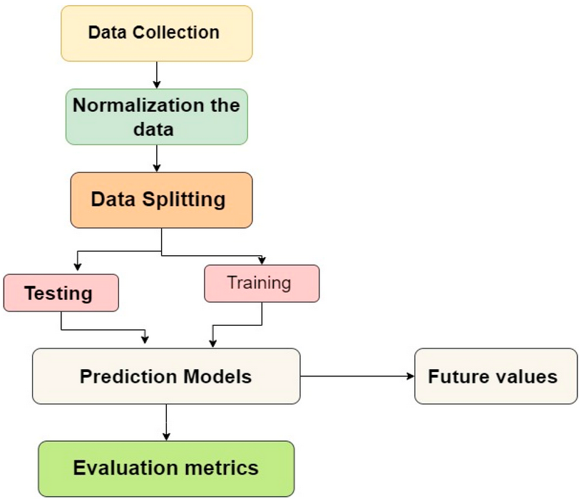
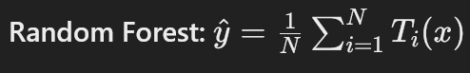
15
3. Analytical Techniques
Used K-Fold Cross-Validation.
Identified important features via Random Forest and XGBoost.
Applied hyperparameter tuning.
4. Evaluation Metrics
RMSE: Measures prediction error.
R² Score: Indicates model fit.
Visualizations: Compared predicted vs actual values, residuals, and feature importance.
5. Mathematical Formulations
Linear Regression: y=β0+β1x1+…+βnxn+ϵy=β0​+β1​x1​+…+βn​xn​+ϵ
Random Forest: y^=1N∑i=1NTi(x)y^​=N1​∑i=1N​Ti​(x)
XGBoost Objective: Loss + Regularization.
SVR: Epsilon-insensitive loss.

Slide 17
16
HARDWARE / SOFTWARE TOOLS AND SIMULATION / DESIGN PARAMETERS
Hardware Requirements: 16GB RAM, a modern i7 or Ryzen 7 CPU. This will provide a smoother experience and allows to experiment more easily with different models and hyperparameters.
Data Format: The data should be in a suitable format for processing (e.g., CSV, Pandas DataFrame).
Software Requirements: Python programming language with libraries like Pandas, NumPy, Scikit-learn, XGBoost, Matplotlib and Seaborn.
Performance: The model should achieve a high level of accuracy in predicting XRP prices (low RMSE, high R2) and should train to generate predictions within a reasonable timeframe.
Scalability: The model should be able to handle large datasets of historical XRP price data.
Robustness: The model should be robust to noisy or incomplete input data.

Slide 18
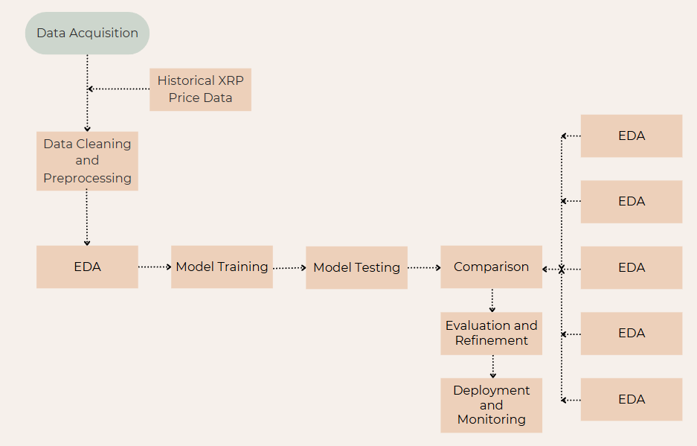
17
WORKFLOW MODEL
Data Acquisition
Data Cleaning and Processing
Exploratory Data Analysis
Model Training and Testing
Evaluation and Refinement
Deployment and Monitoring

Slide 19
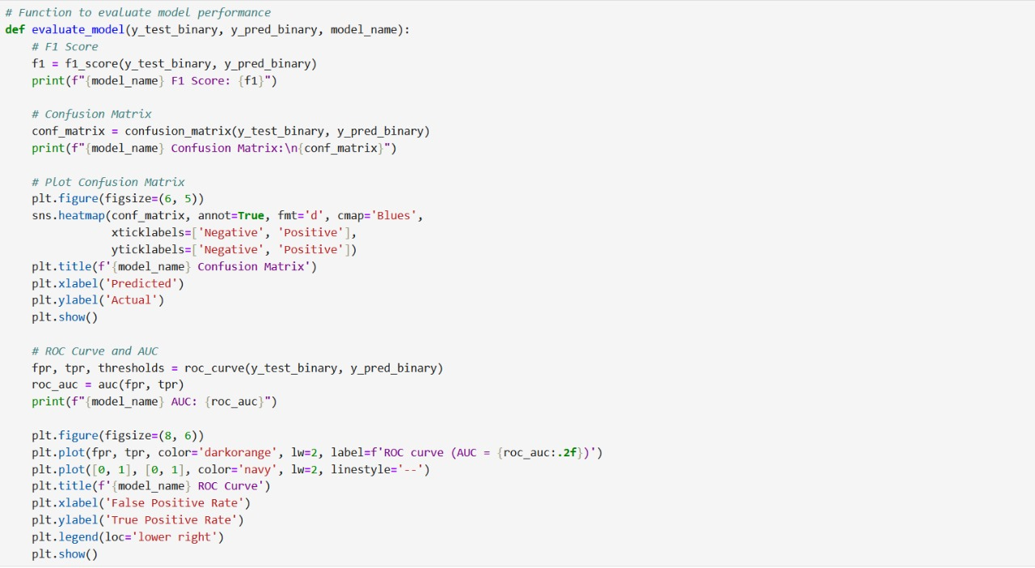
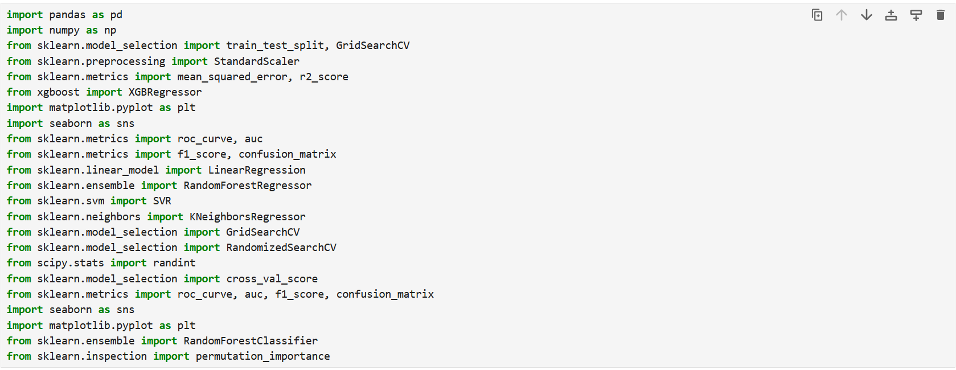
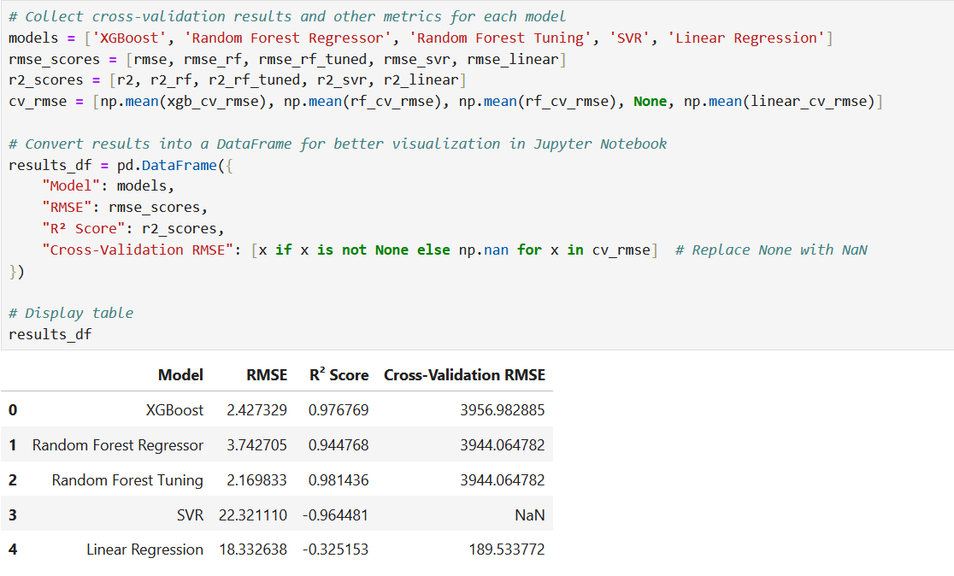
18
DESIGN AND IMPLEMENTATION

Slide 20
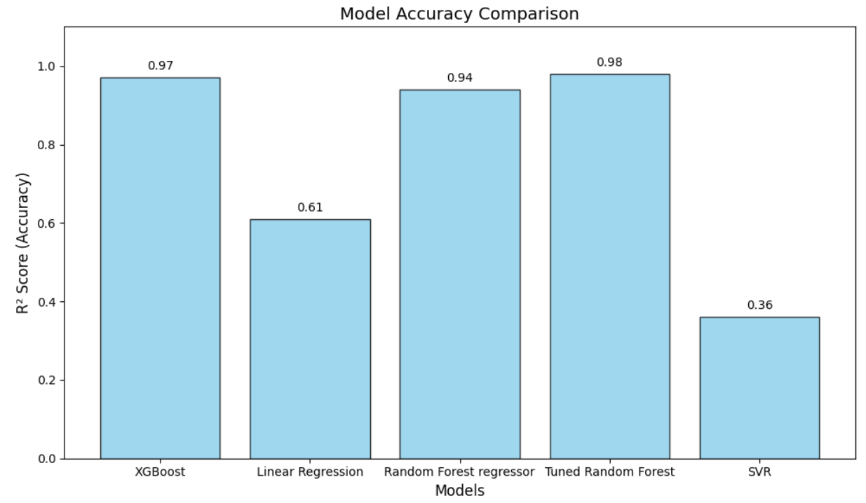
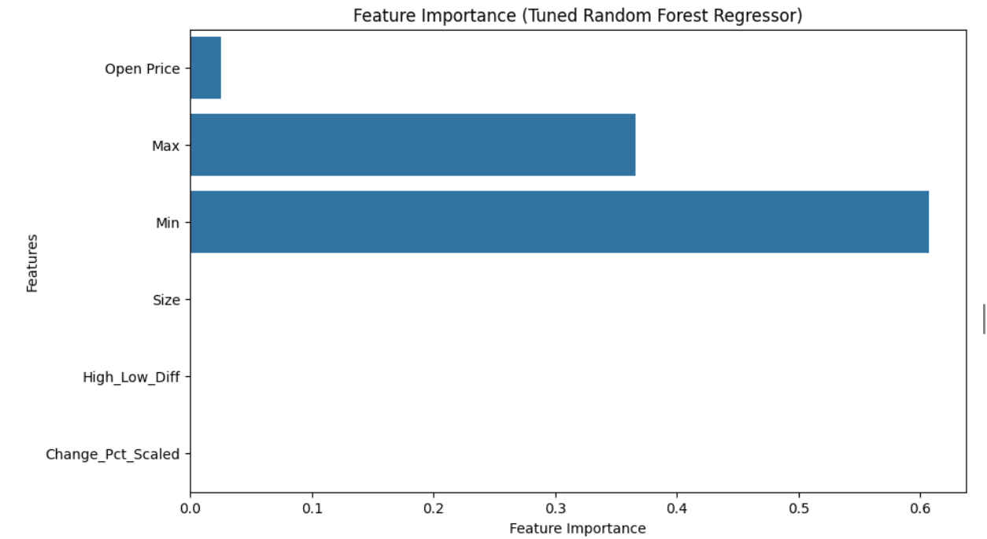
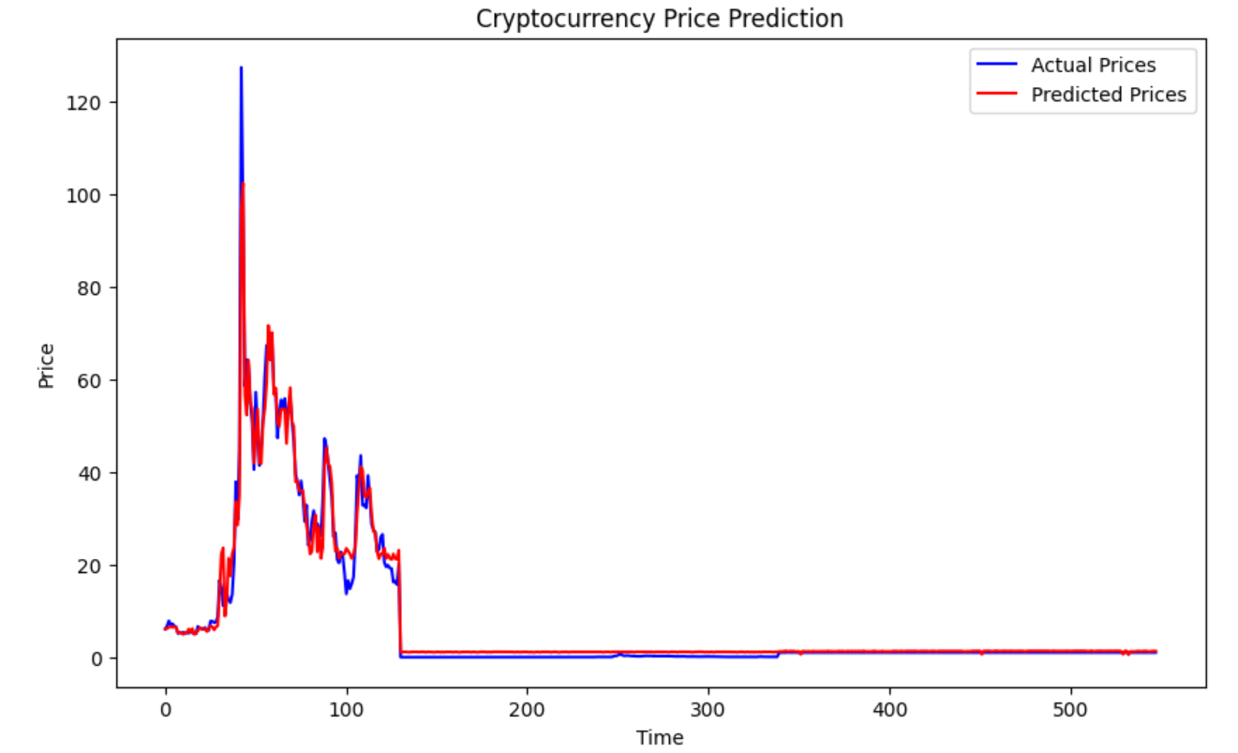
RESULT ANALYSIS
19

Slide 21
CONCLUSION
20
Machine learning models were developed to predict XRP cryptocurrency returns.
Tuned Random Forest and XGBoost achieved the highest accuracies with R² scores of 0.98 and 0.97 respectively.
Linear Regression and SVR models performed comparatively lower due to data complexity.
Ensemble models like Random Forest and XGBoost proved highly effective for handling cryptocurrency volatility.
The study shows that machine learning can capture non-linear patterns in cryptocurrency price movements.
Future improvements can include advanced deep learning models like LSTM for enhanced prediction accuracy.

Slide 22
CONTRIBUTION OF INDIVIDUAL TEAM MEMBERS
21
Teammate 1: Loukya
Loukya played a pivotal role in the initial stages of the project, focusing primarily on data preparation and feature engineering. She was responsible for cleaning and preprocessing the dataset, handling missing values using techniques such as forward fill and mean imputation. Additionally, she created new meaningful features like the high-low price difference and the scaled percentage change to enhance model performance. She also conducted exploratory data analysis (EDA) to understand the dataset's structure and behavior, which guided the subsequent model-building steps. Furthermore, Loukya contributed to developing the baseline models and ensured consistent scaling across all machine learning models using StandardScaler.
Teammate 2: Pranavi
Pranavi contributed significantly to model selection, training, and evaluation. She led the implementation of various regression models including XGBoost, Random Forest Regressor, Support Vector Regression, and Linear Regression. She designed and executed hyperparameter tuning strategies using GridSearchCV and RandomizedSearchCV to optimize model performance. Pranavi also evaluated models using metrics such as RMSE and R² score and performed cross-validation to ensure generalizability. Additionally, she conducted model comparison and visualized feature importances using tools like permutation importance and coefficient analysis. Her efforts extended to evaluating classification-based metrics such as F1 score, confusion matrix, and ROC-AUC, and she successfully applied the best performing model to unseen test data for final predictions.

Slide 23
IMPACT OF THE PROJECT ON SOCIETY AND ENVIRONMENT
22
Improved Financial Decision-Making: The project aids investors, traders, and financial analysts by providing more accurate XRP return predictions, helping them make informed investment decisions.
Promotion of Technological Advancement: Encourages the use of machine learning in financial forecasting, fostering innovation in the fields of FinTech and data science.
Economic Empowerment: By reducing financial risk through predictive insights, the project can empower individuals and small businesses participating in the cryptocurrency market.
Environmental Considerations: As the project is computational and software-based, it has minimal direct environmental impact compared to traditional financial sectors or physical industries.
Awareness of Sustainable Digital Practices: Promotes responsible and efficient use of computational resources, supporting the broader goal of sustainable technology adoption.

Slide 24
OUTCOME – PUBLICATION / PATENT / CONFERENCE / BOOK CHAPTER
23
Submitted our research paper to 5th International Conference on Advances and Applications of Artificial Intelligence and Machine Learning (ICAAAIML 2025).
The conference is an international forum which aims to bring together leading academicians, researchers and research scholars to exchange and share their experiences and hard-earned technological advancements and applications in Artificial Intelligence and Machine Learning.
It is conducted by Sharda University which is a prestigious and top NIRF ranking university.

Slide 25
REFERENCES
24
Huang, J. Z., Huang, W., & Ni, J. (2019). Predicting bitcoin returns using high-dimensional technical indicators. The Journal of Finance and Data Science, 5(3), 140-155.
Ahmad, T., & Abbas, M. (2024). AI Based Cryptocurrency Price Prediction: A Comparative Analysis of Traditional & Deep Learning Models with Sentiment Integration (Master's thesis, UIS).
Khan, F. U., Khan, F., & Shaikh, P. A. (2023). Forecasting returns volatility of cryptocurrency by applying various deep learning algorithms. Future Business Journal, 9(1), 25.
Hafid, A., Ebrahim, M., Rahouti, M., & Oliveira, D. (2024, November). Cryptocurrency Price Forecasting Using XGBoost Regressor and Technical Indicators. In 2024 IEEE International Performance, Computing, and Communications Conference (IPCCC) (pp. 1-6). IEEE
Omole, O., & Enke, D. (2024). Deep learning for Bitcoin price direction prediction: models and trading strategies empirically compared. Financial Innovation, 10(1), 117.
Mahapatro, S., Sahu, P. K., & Subudhi, A. (2024). Navigating XRP Volatility: A Deep Learning Perspective on Technical Indicators. International Journal of Advanced Computer Science & Applications, 15(6).
Li, X., Liu, Y., Liu, Z., & Zhu, S. (2024). Cryptocurrency return prediction: A machine learning analysis. Available at SSRN 4703167.
Falcon, A., & Lyu, T. (2021). Daily cryptocurrency returns forecasting and trading via machine Learning. Journal of Student Research, 10(4).
Wu, J., Zhang, X., Huang, F., Zhou, H., & Chandra, R. (2024). Review of deep learning models for crypto price prediction: implementation and evaluation. arXiv preprint arXiv:2405.11431.
Sun, G. (2024). Cryptocurrency price prediction based on Xgboost, LightGBM and BNN. Applied and Computational Engineering, 49, 273-279.

Slide 26
25
REFERENCES
Yuan, Z. (2023). Gold and Bitcoin Price Prediction based on KNN, XGBoost and LightGBM Model. Highlights in Science, Engineering and Technology, 39, 720-725.
Akila, V., Nitin, M. V. S., Prasanth, I., Reddy, S., & Kumar, A. (2023). A Cryptocurrency Price Prediction Model using Deep Learning. In E3S Web of Conferences (Vol. 391, p. 01112). EDP Sciences.
Gurgul, V., Lessmann, S., & Härdle, W. K. (2023). Forecasting Cryptocurrency Prices Using Deep Learning: Integrating Financial, Blockchain, and Text Data. arXiv preprint arXiv:2311.14759.
HEXSPOOR, F. DEEP LEARNING TO PREDICT CHANGE IN XRP CRYPTOCURRENCY PRICE USING TWITTER AND HISTORIC DATA (Doctoral dissertation, tilburg university)
Koki, C., Leonardos, S., & Piliouras, G. (2022). Exploring the predictability of cryptocurrencies via Bayesian hidden Markov models. Research in International Business and Finance, 59, 101554.
Wardak, A. B., & Rasheed, J. (2022). Bitcoin cryptocurrency price prediction using long short-term memory recurrent neural network. Avrupa Bilim ve Teknoloji Dergisi, (38), 47-53.
Chakraborty, A., Hatsuda, T., & Ikeda, Y. (2023). Projecting XRP price burst by correlation tensor spectra of transaction networks. Scientific Reports, 13(1), 4718.
Ammer, M. A., & Aldhyani, T. H. (2022). Deep learning algorithm to predict cryptocurrency fluctuation prices: Increasing investment awareness. Electronics, 11(15), 2349.
Singh, P. K., Pandey, A. K., & Bose, S. C. (2023). A new grey system approach to forecast closing price of Bitcoin, Bionic, Cardano, Dogecoin, Ethereum, XRP Cryptocurrencies. Quality & Quantity, 57(3), 2429-2446.
Ali, M., & Shatabda, S. (2020, November). A data selection methodology to train linear regression model to predict bitcoin price. In 2020 2nd International Conference on Advanced Information and Communication Technology (ICAICT) (pp. 330-335). IEEE.

Slide 27

THANK YOU

